Slide 1
The Unknown AI
AI Powered Search

Slide 2
Table of contents
01
04
02
05
03
06
Introduction
Search Functionality
Problem and solution
Limitations and Future Work
Approach Overview
Conclusion

Slide 3

Whats is AI Powered Search?
AI-powered search engines can understand the context, intent, and meaning behind search queries, allowing them to provide more meaningful and personalized results. These systems can analyze and interpret large volumes of unstructured data, such as text documents, images, audio, and video, to extract valuable insights and deliver more precise search results.

Slide 4
01
Introduction

Slide 5
Introduction
Our Goal
Our idea
Fastest and most Optimized search results with the help of Ai
To explore how artificial intelligence is transforming the way we retrieve information

Slide 6
(02) Problem Statement
Time
Precision
Information Overload

Slide 7
(03) Approach Overview
Our AI-based search application employs a combination of natural language processing, machine learning, and information retrieval techniques. We preprocess the data, extract meaningful features, and utilize algorithms to rank search results based on relevance.

Slide 8
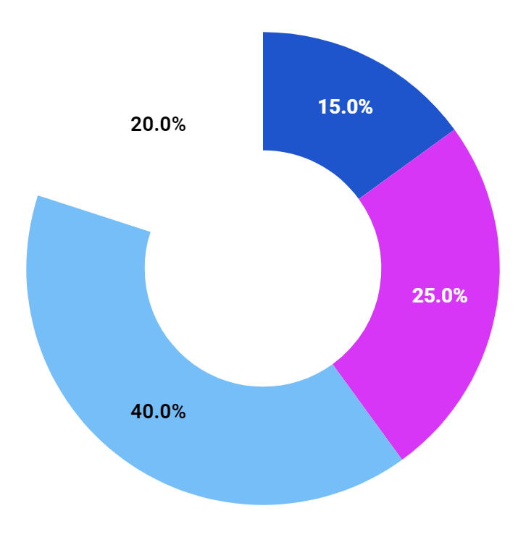
(04) Search Functionality
TF-IDF
Angular
Python
JN IDE

Slide 9
(05)Limitations And Future Work
User Experience
Innovate solutions
Advance Analytic Support
Profitable for Large Co.

Slide 10
(06) Conclusion
By leveraging AI techniques, we provide more accurate and relevant search results, saving users time and effort in finding the information they need. This technology has the potential to revolutionize information retrieval and improve user satisfaction across various domains.

Slide 11
Thanks
Any Questions?

